Slide 1
Neural Language Model
Dr. S. Prabakeran
Teaching Assistant
Birla Institute of Technology & Science, Pilani

Slide 2
Agenda
Neural Language Models
How Large Language Models Work
Feedforward Neural Network Basics
Transformers for beginners - What are they and how do they work?
Inside the Transformer Architecture
How a Transformer works in machine translation
Summary
Demo Session

Slide 3
Neural Language Models
Introduction to Neural Language Models
Applications of Neural Language Models
Input Representations in Neural Language Models
Structure of a Simple Neural Language Model
Pretraining and Learning Word Embeddings
Embedding Matrix and Model Optimization
Visualization of Neural Language Model with Embedding Layer

Slide 4
How Large Language Models Work
Introduction to GPT
Large Language Models and Foundation Models
Scale of Text Data and Model Parameters
Components of Large Language Models
Training Process of Large Language Models
Fine-Tuning for Specific Tasks
Business Applications of Large Language Models

Slide 5
Feedforward Neural Network Basics
Intuition Behind Feedforward Neural Network Design
Structure of Feedforward Neural Networks
General Flow of a Feedforward Neural Network
Prediction Process in Feedforward Neural Networks
Relationship Between Neural Networks and Deep Learning
Differentiating Neural Networks in Depth
Power of Neural Networks Over Traditional Models
Feature Usage in Neural Networks

Slide 6
Transformers for beginners - What are they and how do they work ?
The Rise of Transformers in NLP
Inside the Transformer Architecture
Key Ideas in Transformer Architecture
Multi-Headed Attention
Understanding Multi-Headed Attention in Transformers
Positional Encoding: A Solution to Word Order Ambiguity
Bringing It All Together: How Transformers Operate
Final Thoughts on Transformers: Simplicity in Complexity

Slide 7
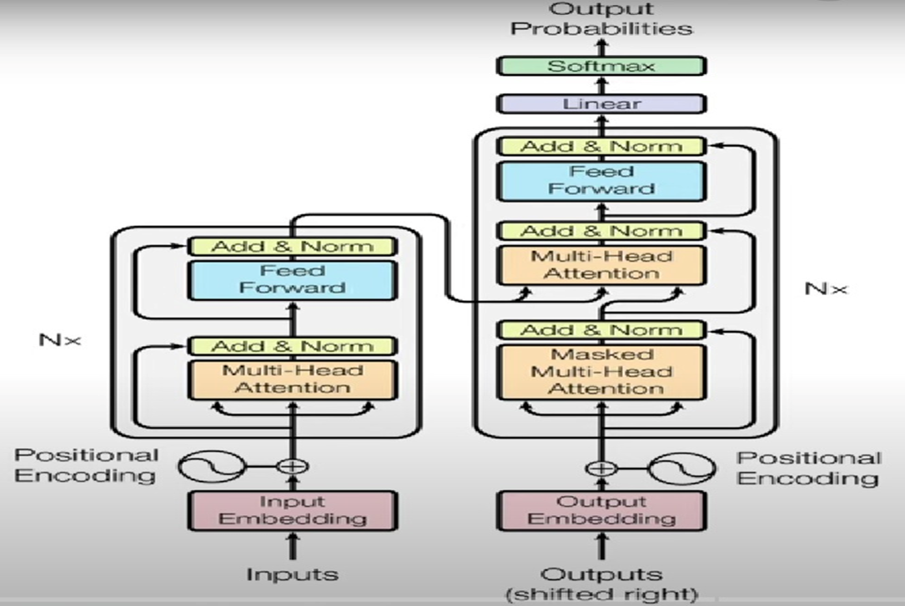
Inside the Transformer Architecture

Slide 8
Inside the Transformer Architecture…
Input Embedding
Positional Encoding
Multi-Head Attention: Query, Key-Value, Attention, Weighted Sum
Add & Norm
Feed Forward
Output Embedding
SoftMax

Slide 9
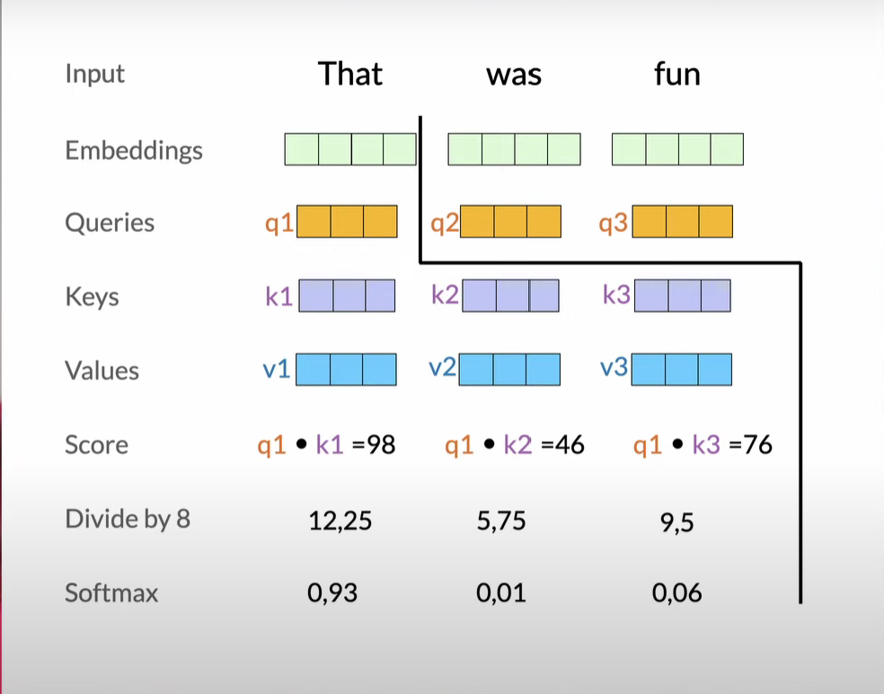
Multi-Head Attention: Query, Key-Value, Attention, Weighted Sum…

Slide 10
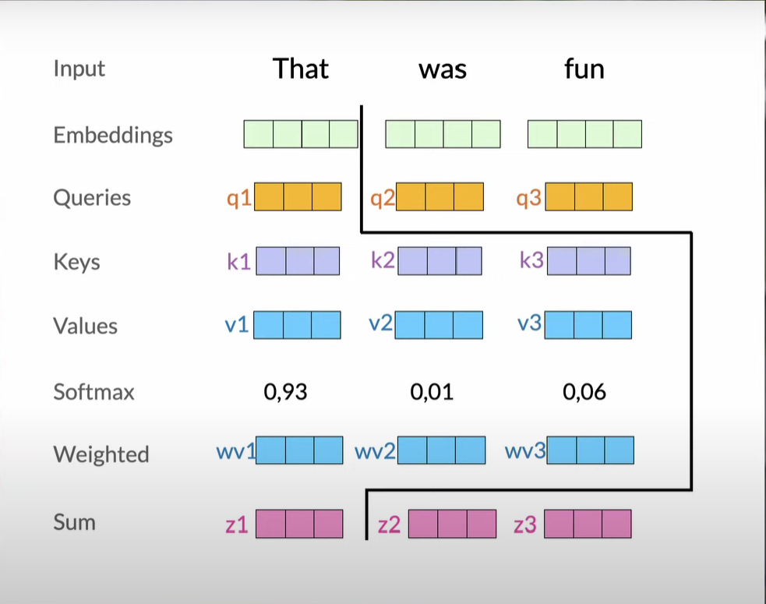
Multi-Head Attention: Query, Key-Value, Attention, Weighted Sum…

Slide 11
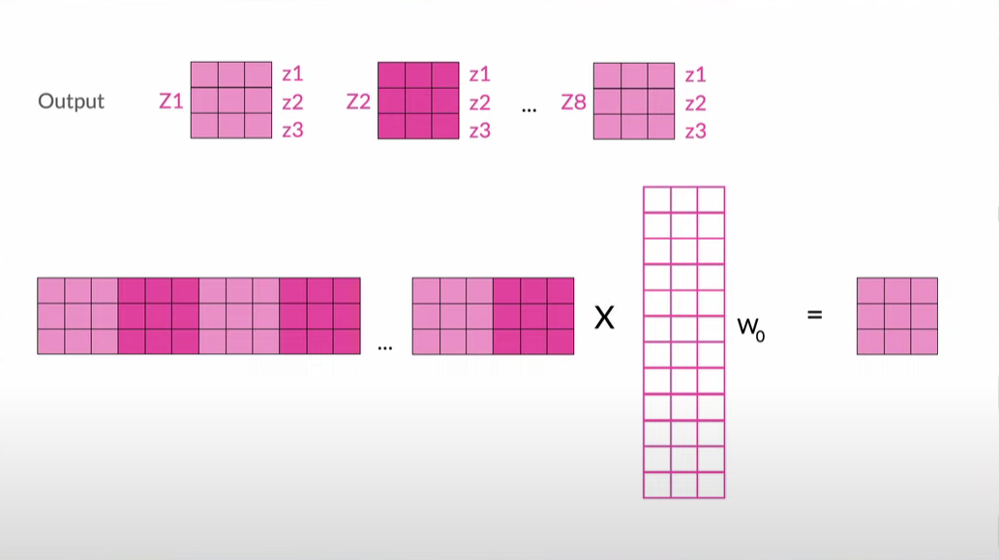
Multi-Head Attention: Query, Key-Value, Attention, Weighted Sum…

Slide 12
How a Transformer works in machine translation ?
Translate the English sentence "The cat sat on the mat" into French.
Input Embedding:
Each word in the English sentence is converted into a numerical representation (embedding).
"The" becomes a vector of numbers, "cat" becomes a different vector, and so on.
Positional Encoding:
Information about the word order is added to the embeddings.
This helps the model understand that "cat" comes before "mat" in the sentence.
Multi-Head Attention:
The model focuses on the relationships between different words in the sentence.
It learns to pay more attention to words that are closely related, like "cat" and "mat."

Slide 13
How a Transformer works in machine translation ?...
Translate the English sentence "The cat sat on the mat" into French.
Feed Forward:
The model applies additional processing to the information it has gathered.
This helps it make more complex decisions about how to translate the sentence.
Output:
The model generates the French translation, "Le chat s'est assis sur le tapis."

Slide 14
DEMO Session on Machine Translation

Slide 15
DEMO Session on Text Classification using Neural Networks

Slide 16
Thank you

